Slide 1
Lab-Corps Pilot Summary
February 2015
EERE Office of Strategic Programs
Technology-to-Market

Slide 2




Lab-Corps Pilot
Lab-Corps Vision: Empower leading National Lab researchers to successfully transition their discoveries into high-impact technologies in the marketplace.
Program Goals (Long-Term):
Increase the number of lab-developed technologies that are transferred into commercial development or industry agreements.
Train lab researchers to better understand the commercialization process and private sector needs.
Strengthen entrepreneurial culture and institutional support for commercialization activity at the national labs.
Funds: $2.3M from EERE Tech-to-Market (FY15), FY16 budget request
Successful precedent:
NSF I-Corps Program: 300+ teams trained, 125+ startups created, higher SBIR selection rate
10+ ARPA-E teams have successfully completed I-Corps since 2013
NIH completed successful I-Corps pilot in December 2014
Other agencies currently exploring I-Corps models

Slide 3
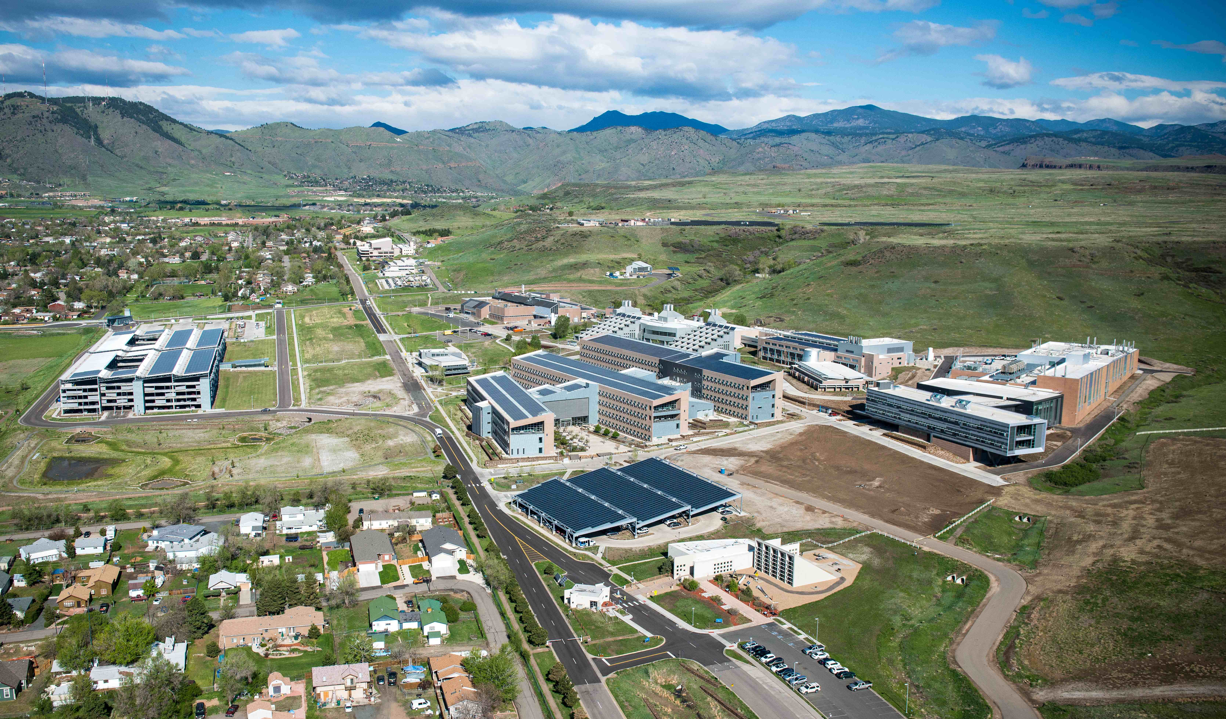
Lab-Corps: Pilot Program Winners
Lab-Corps Node: National Renewable Energy Laboratory

Slide 4
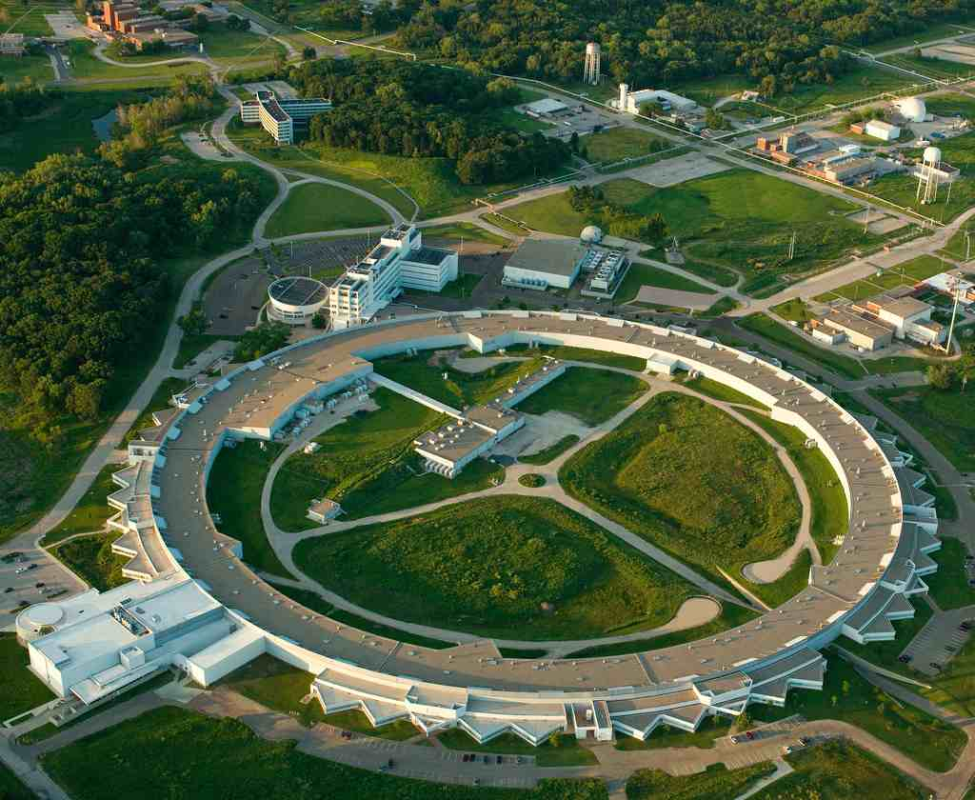
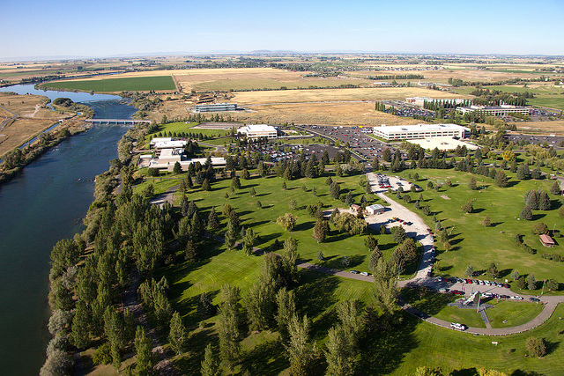
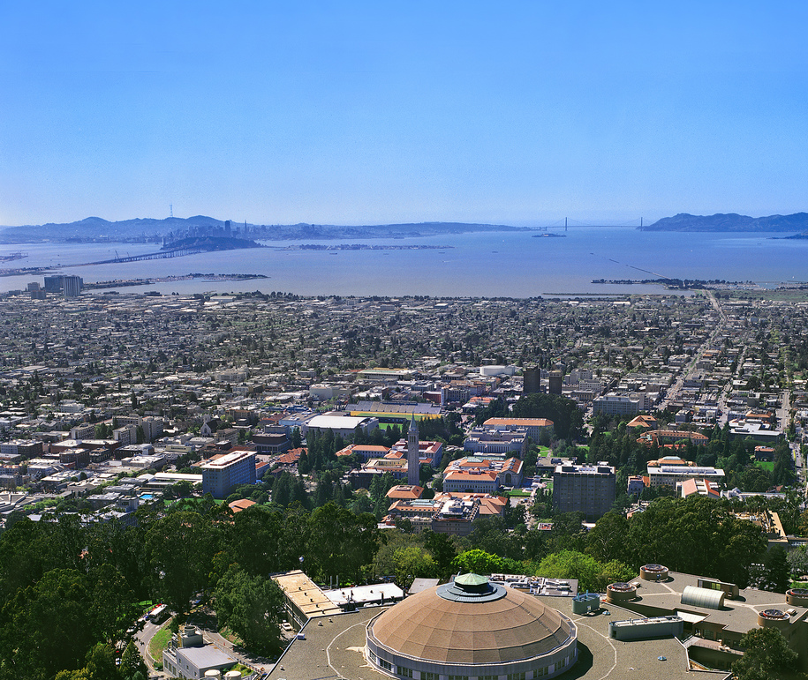
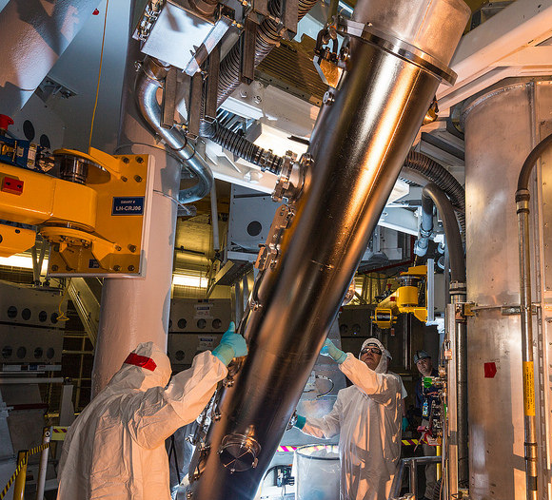
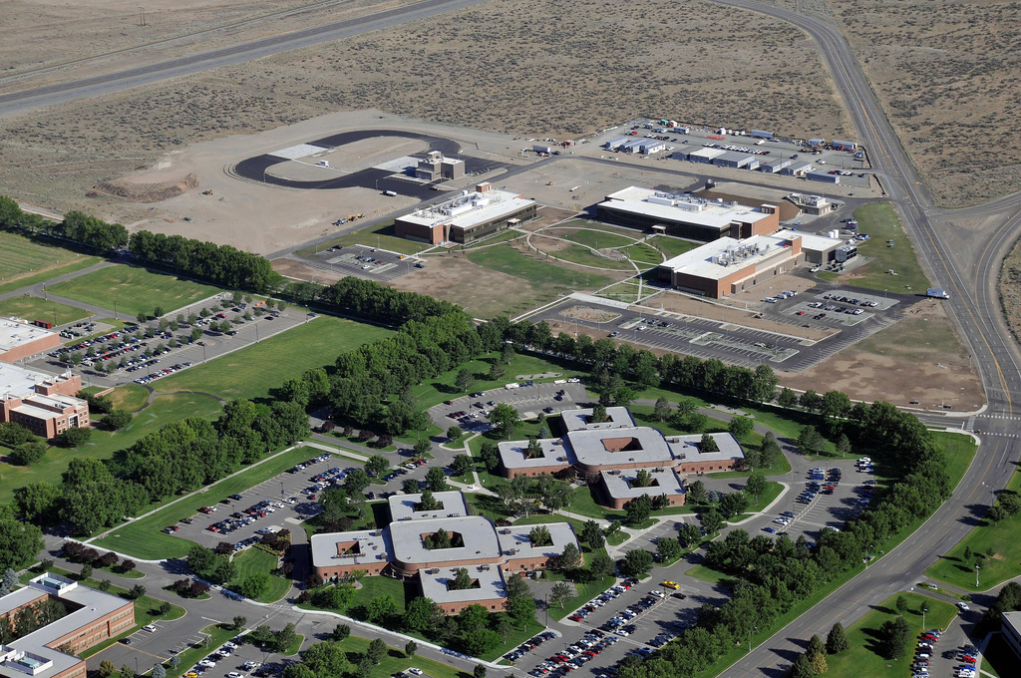
Lab-Corps: Pilot Program Winners
Lab-Corps Sites:
Argonne National Laboratory
Idaho National Laboratory
Lawrence Berkeley National Laboratory
Lawrence Livermore National Laboratory
Pacific Northwest National Laboratory

Slide 5
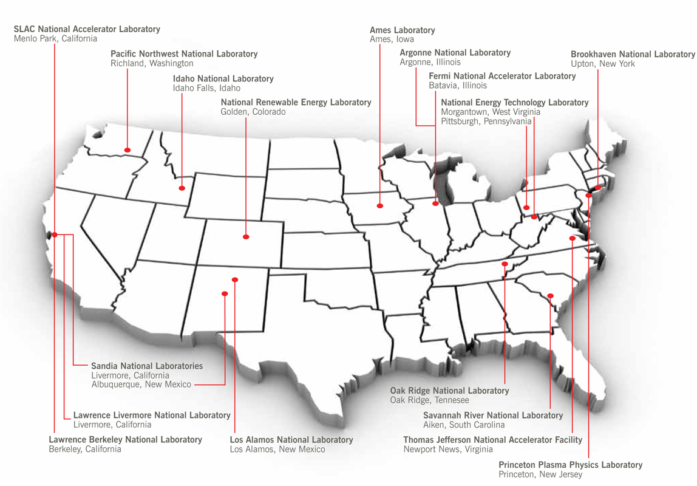
Lab-Corps: A National Network to Enhance Lab Impact
PNNL
INL
Fermi
ANL
BNL
LBNL
NREL
LLNL / SNL-CA
Node
ORNL
LANL
Site
SNL
Partner

Slide 6


Lab-Corps Pilot Process
CRADA
Lab Sites
License
Teams
Teams
Commercialization Training
Customer &
Value Discovery
Node
Teams
Startup
Lab Sites
Other Partnership
No-Go / Further RD&D

Slide 7
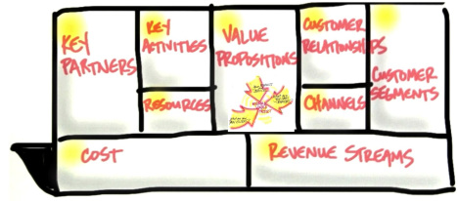
Lab-Corps Pilot Training
Training Program
Hands-on, experiential customer discovery process based on Lean LaunchPad
6 weeks with expert instructor team: 3-day opening session, weekly virtual sessions, 2-day closing session
Scientific method for commercialization: develop and test key hypotheses on how to commercialize your technology
Open to all commercialization pathways and incorporates special, customized content for national lab setting

Slide 8

Lab-Corps Pilot Teams
Team Structure:
Lab researcher
Entrepreneurial lead
Industry mentor
Total Number of Pilot Teams: 10-15
The first teams will be selected by April/May 2015.
Team Cohorts:
3 teams will participate in the existing I-Corps Energy and Transport Regional Program at the University of Michigan in May-June, in order to better inform the customized curriculum.
7+ teams will participate in a full, customized Lab-Corps training that will begin in October 2015. Additional teams may participate, supported by EERE Technology Offices and/or independent National Laboratory funds.

Slide 9



Lab-Corps Pilot Timeline
Step 1:
EERE selected 1 lab as training ‘Node’ and 5 labs as ‘Sites’
Step 2:
Lab Sites assemble teams to participate in training (2 per lab)
Step 3:
Node develops custom Lab-Corps Training Curriculum
Step 4:
Teams participate in Lab-Corps training
(6 weeks)
Step 5:
Independent Evaluation and Pilot Completion
Timeframe
Q1 FY15 | Q2 FY15 | Q2-Q3 FY15 | Q4 FY15–Q1 FY16 | Q1-Q2 FY16

